Slide 1
Heart Attack Analysis and Prediction
Christina Chi, Yujia Dai, Zexin Lin
Coco Liu, Qirui Wang, Minhao Zhang
May 2023
Notes:
We are group 1 and I’m Qirui, I will go over our project about heart attack analysis and prediction. Other members are Christina Chi, Yujia Dai, Zexin Lin, Coco Liu, and Minhao Zhang. Our dataset contains 13 features representing different measures and one label with 1 meaning more chance of heart attack and 0 meaning less chance of heart attack.

Slide 2
Introduction
Age : Age of the patient
Sex : Sex of the patient
exang/exng: exercise induced angina (1 = yes; 0 = no)
ca: number of major vessels (0-3)
cp : Chest Pain type
Value 1: typical angina
Value 2: atypical angina
Value 3: non-anginal pain
Value 4: asymptomatic
trtbps : resting blood pressure (in mm Hg)
chol : cholestoral in mg/dl fetched via BMI sensor
fbs : (fasting blood sugar > 120 mg/dl) (1 = true; 0 = false)
rest_ecg : resting electrocardiographic results
Value 0: normal
Value 1: having ST-T wave abnormality (T wave inversions and/or ST elevation or depression of > 0.05 mV)
Value 2: showing probable or definite left ventricular hypertrophy by Estes' criteria
thalach : maximum heart rate achieved
oldpeak: ST depression induced by exercise relative to rest
slp: the slope of the peak exercise ST segment (0-2)
Thall: Thal rate (1-3)
A dataset for heart attack classification (binary)
The response variable: “Output”
1 - more chance of heart attack
0 - less chance of heart attack
13 features
https://www.kaggle.com/datasets/rashikrahmanpritom/heart-attack-analysis-prediction-dataset?select=heart.csv
Notes:
Our dataset contains 13 features representing different measures and one label with 1 meaning more chance of heart attack and 0 meaning less chance of heart attack.

Slide 3
Question
Based on the provided characteristics, are the most important risk factors for heart attacks discernible?
Any patterns or trends in the data that could point to viable strategies for lowering the risk of heart attacks?
Can we reliably forecast the risk of having a heart attack using machine learning algorithms, and how effective is this model?
Can we use bootstrap to investigate the correlation between gender, age, type of chest pain and maximum heart rate and heart attack in our dataset since these 4 attributes can be easily measured at home by the patient.
Notes:
With this dataset, we come up with these questions, which risk factors for heart attacks are discernible? Is there any patterns could help us find viable strategies for lowering heart attack risk? Could we train a model to predict it? And how confident are these results?

Slide 4
Question
Based on the provided characteristics, are the most important risk factors for heart attacks discernible? (correlation matrix)
Any patterns or trends in the data that could point to viable strategies for lowering the risk of heart attacks? (analyzing the coefficients)
Can we reliably forecast the risk of having a heart attack using machine learning algorithms, and how effective is this model? (logistics regression, and f-score)
Can we use bootstrap to investigate the correlation between gender, age, type of chest pain and maximum heart rate and heart attack in our dataset since these 4 attributes can be easily measured at home by the patient. (Bootstrap, CI)

Slide 5
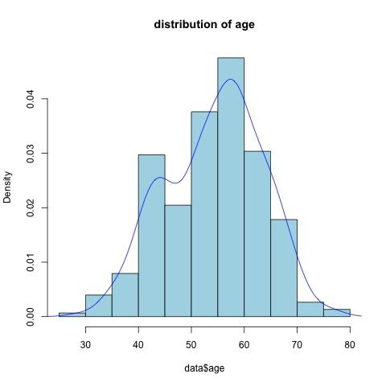
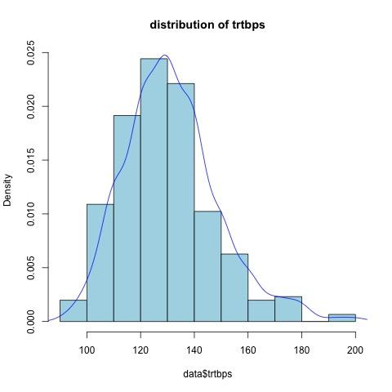
EDA - Data Distribution
Notes:
Firstly, we did exploratory data analysis. Using histogram and kernel density estimation, we find that all of the continuous variables do not skew too much and roughly follow a normal distribution, here is the result.

Slide 6
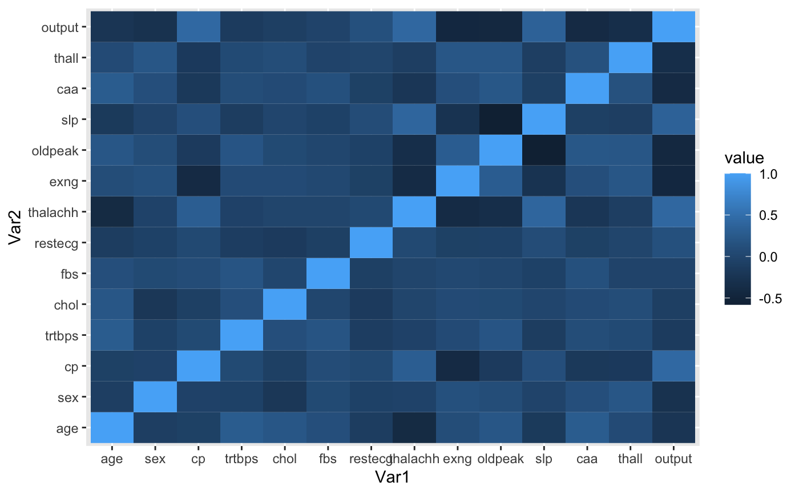
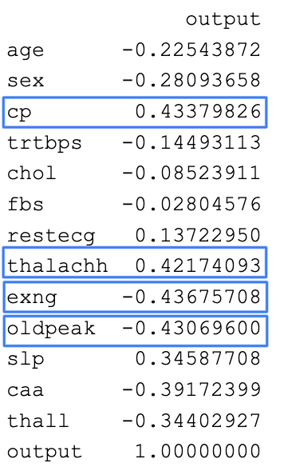
EDA - Correlation
All correlation score has absolute value smaller than 0.7, so we do not need remove variables.
Notes:
And we calculate correlation matrix, to find any apparent relations between variables and also for feature selection. This is the heatmap and correlation scores between features and output. We find all correlation score has absolute value smaller than 0.7, so we do not need to remove any variables.

Slide 7
Data Processing
Handling null values
Delete null values
Featuring Scaling
Normalize data to prevent over-fitting
Notes:
Before the modeling, we have data processing including handling null values and feature scaling for our data. We choose to delete null values but all data points are complete so we delete none of them. We also normalized data to prevent learnable coefficients to be too sensitive to large samples.

Slide 8
Correlation Matrix
Last Column of the Correlation Matrix
4 Most Correlated Features:
CP: Chest Pain Type
Thalachh: Maximum Heart Rate Achieved
Exng: Exercise induced angina
Oldpeak: ST depression induced by exercise by exercise relative to rest.
We first choose these 4 features to model
Notes:
Figure on right is the Correlation (Relationship) between our features and Output (More likely to have heart attack or less likely). The features of blue box has the maximum absolute value of the correlation.

Slide 9
Model Summary
Notes:
Here, we use Logistic Regression model to model with 4 most correlated features mentioned on last slide.
CP: Chest Pain
Thalach: Max Heart rate achieved
Exng: Exercise induced angina Oldpeak: ST depression induced by exercise by exercise relative to rest.

Slide 10
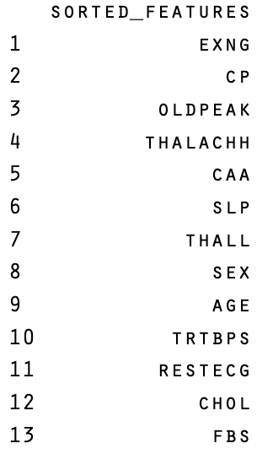
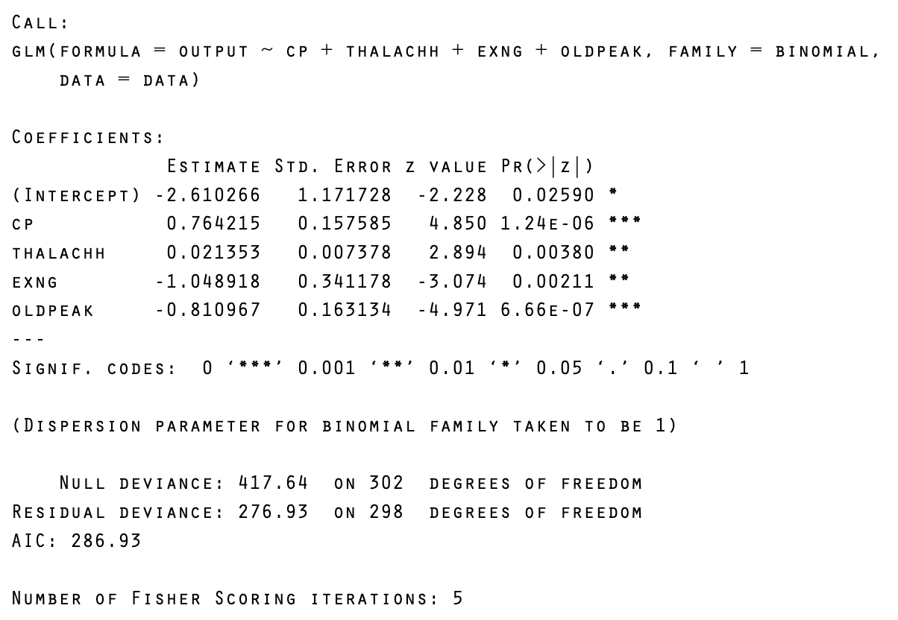
Modeling

Slide 11
Model Selection - CV
Sort the features based on the absolute value of correlation scores between features and output in descending order
Model with features:
1st Model - Feature 1
2nd Model - F1 + F2
…
13th Model - All Features
Perform 5-fold CV on all models
Best Model use 8 features: Exng, cp, oldpeak, thalachh, caa, slp, thall, sex
Accuracy: 85.33%
Notes:
Move to model selection, where we used cross-validation. We sorted the features based on absolute value of correlation scores between features and output in descending order, here is the models with corresponding features. Then we perform 5-fold CV on models. This results in the best model with these 8 features and achieve validation accuracy about 85%.

Slide 12
Bootstrap to Estimate the accuracy
Using Bootstrap to Estimate Accuracy
10000 Iterations (B = 10000)
Validation & Train set - 2:8 split
Model with 8 features (from previously slide)
Notes:
With the selected model, we used boostrapping to estimate the accuracy with B = 10000. Here is the result, we get 85% mean accuracy and 87% mean F-score which means the model is pretty good at prediction.

Slide 13
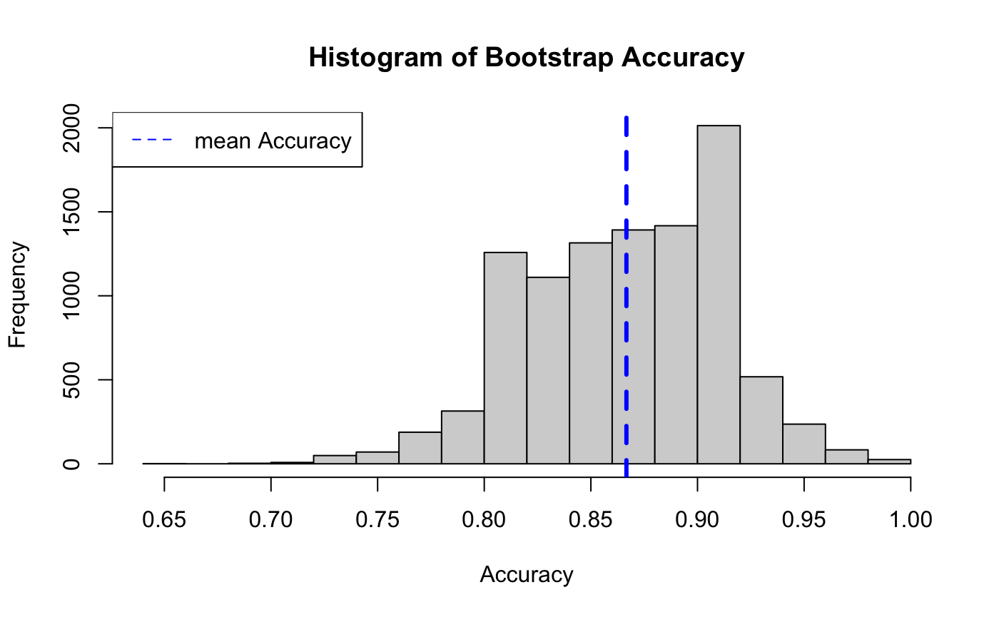
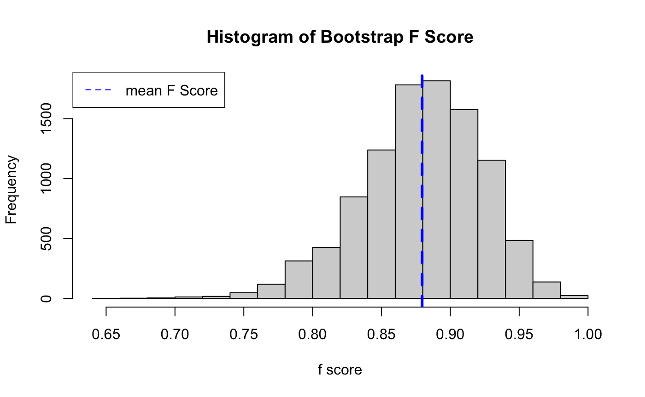
Results
85.8% Mean Accuracy
0.046% Standard Error
87.2% Mean F-score
0.044% Standard Error
Notes:
Here is the result, we get 85% mean accuracy and 87% mean F-score which means the model is pretty good at prediction.

Slide 14
95% CI of the Model Parameters
Variables | constant | exng | cp | oldpeak | thalachh | caa | slp | thall | sex
95% CI upper bound | 3.299 | -1.011 | 0.854 | -0.577 | 0.519 | -0.808 | 0.642 | -0.937 | -1.511
95% CI lower bound | 3.191 | -1.058 | 0.829 | -0.604 | 0.491 | -0.839 | 0.600 | -0.975 | -1.562
Notes:
Also we build 95% confidence interval for feature parameters, and for example we can see that the CP contribute more to the results.

Slide 15
Bootstrap to Estimate Correlation Between Variables
We choose 4 variables:
Age
Sex
CP: Chest Pain
Thalachh: Maximum Heart Rate Achieved
These 4 variables are the simplest for people to measure
10000 iterations
Notes:
With our question about finding any viable strategies to prevent heart attack disease, we also used bootstrapping to estimate correlation between age, sex, Chest pain, Maximum heart rate achieved and output.

Slide 16
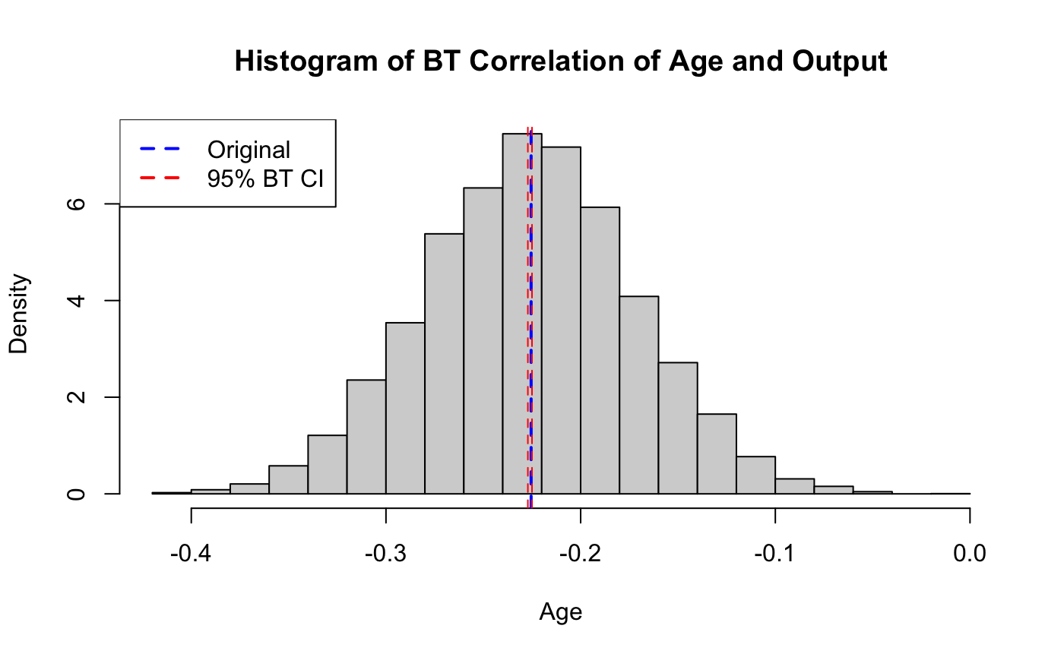
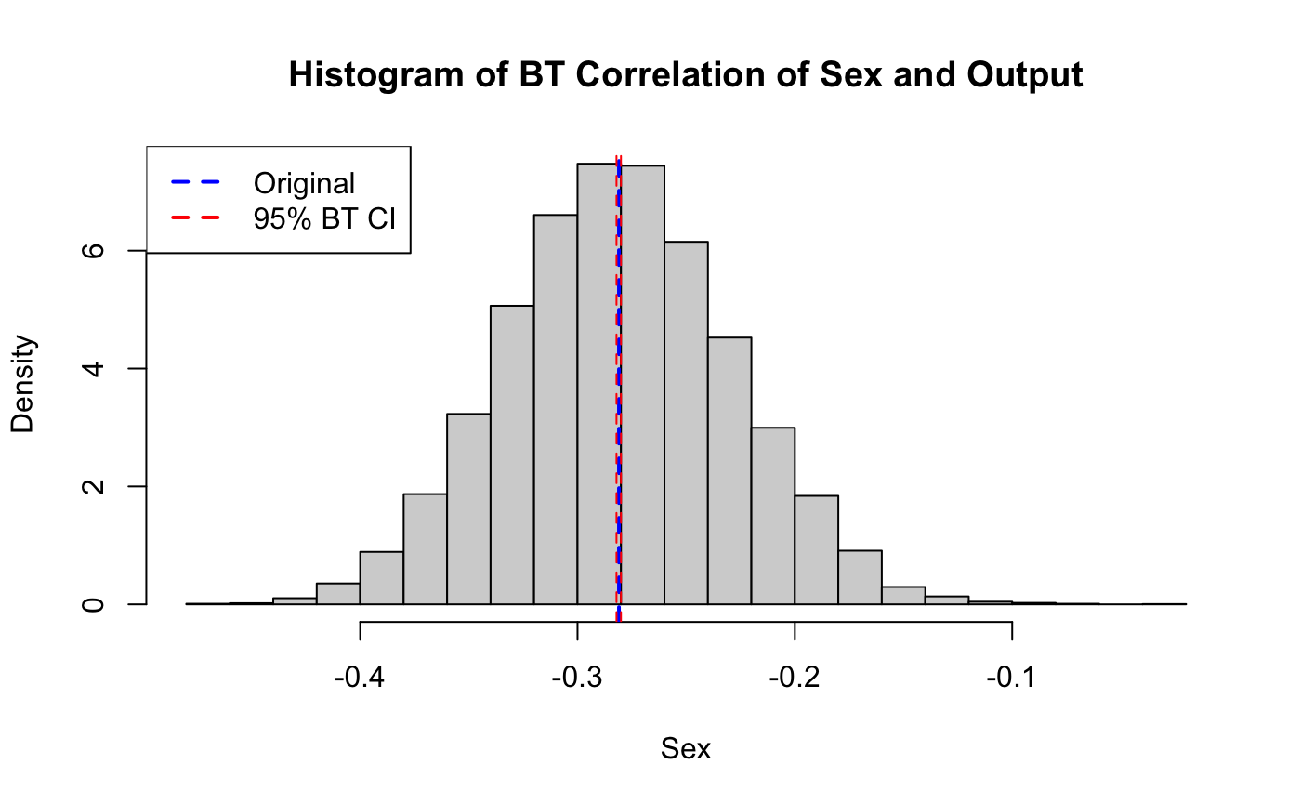
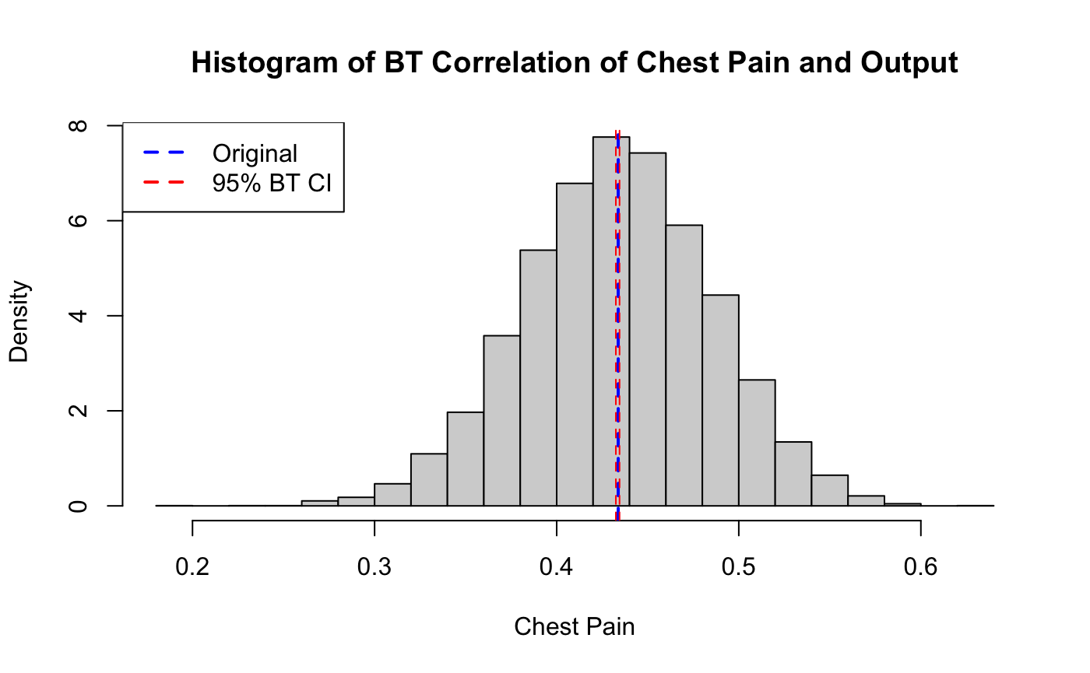
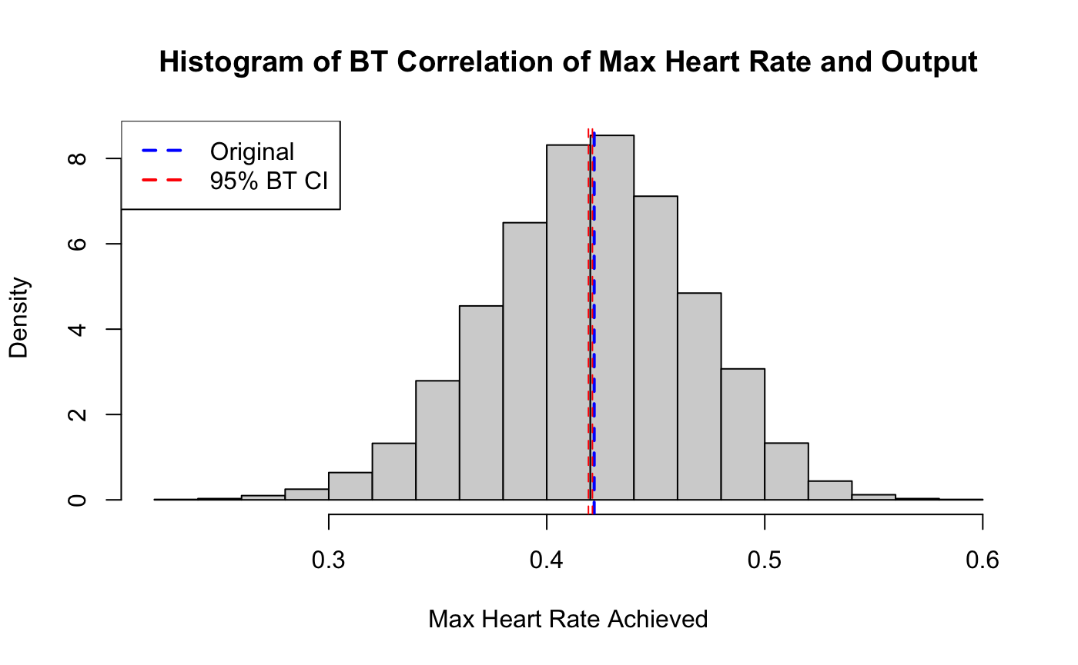
95% CI: [-0.226, -0.224]
95% CI: [-0.282, -0.280]
95% CI: [0.433, 0.435]
95% CI: [0.421, 0.423]
Notes:
We can see that they are not very correlated with the output though chest pain and max heart rate’s score are slightly higher.

Slide 17
Conclusion
Based on our correlation heatmap, the top three correlated variables with the CVD are chest pain type, maximum heart rate achieved and the slope of the peak exercise ST segment.
Based on results and analysis, measuring chest pain and max heart rate achieved at home is not that helpful in diagnosis than medical examination.
In addition, the classification of chest pain categories and the monitoring of the (abnormal) heart rate (e.g., through exercise watches) should be popularized in order to make initial judgments and intervene as early as possible.
Exercise induced angina and the slope of the peak exercise ST segment contribute more to the heart disease.
Notes:
To conclude, there is not very effective strategies we could use at home to diagnose the heart attack disease, and it is better to get medical examination. But measuring exercise induced angina and slope of peak exercise ST segment would be good for monitoring such disease.

Slide 18
Discussion
The dataset is relatively small containing only 304 data points, which means it might not be a good representative of the population.
The model trained by normalized data has the same accuracy as the model trained by unnormalized data, which is also probably due to the small dataset.
To obtain a better model and make better predictions, we could add more synthetic data through data augmentation like SMOTE or collect more data.
Notes:
However, for better prediction, larger dataset would be more representative of the population. Our small dataset results in problems like ineffectiveness of normalization. Collecting more data and using data augmentation would be good strategies for this. That’s all for the presentation, thanks for listening

